Slide 1

Data 603 – Big Data Platforms
Lecture 11
Graph Analytics

Slide 2
Graph Analytics
Graphs
A representation of the relationships between pairs objects.
A graph models “things” and relationships between “things.”
A representation of a set of objects (e.g. people) and the pairwise relationships between them (e.g. friendships)
Data structures composed of nodes (vertices) and edges that define relationships between the nodes.
Vertices are arbitrary objects (people, objects, places, concepts, etc.).
Graph analytics is the process of analyzing the relationships between verticies.
A node represents a person, place, or thing
Edge represents a relationship

Slide 3
Graph Analytics Intro

Slide 4
Graph Terminology
V1
Vertex (or Node)
The object being represented.
Represented by V.
Edges
Representation of pairwise relationships between nodes.
Represented by E.
G = (V,E)
Graph G with vertices V and edges E.
Note: Edges and vertices in graphs can have data associated with them.
E1
E2
V3
V2
E3

Slide 5
Graph Terminology
Directed vs. Undirected Graphs
Directed Graph
Each edge is an ordered pair, with the edge traveling from the first vertex to the second.
The relationship is from a source (or head) vertex to a destination (or tail) vertex.
Edges do not have specified “start” and “end” vertices.
The two ends of the edge play different roles (e.g. parent-child relationship)
Examples:
A link from on the web from page A to page B
A path on the route from Baltimore to Disney World

Slide 6
Graph Terminology
Directed vs. Undirected Graphs
Undirected graph, each edge corresponds to an unordered pair of vertices.
Edges have no arrow; the relationship is symmetrical
A is a friend of B
B is a friend of A

Slide 7
Graph Analytics
Directed vs. Undirected Graphs
V2
V2
V1
V3
V1
V3
V4
V4
Undirected Graph
Directed Graph

Slide 8
Graph Terminology
Cyclic vs. Acyclic Graphs
A cyclic graph contains cycles
A series of vertices connected in a loop.
Poses the risk that traversing of such graph can follow edges in an infinite-loop.
An acyclic graph contains no cycles.
Cyclic Graph
Acyclic Graph

Slide 9
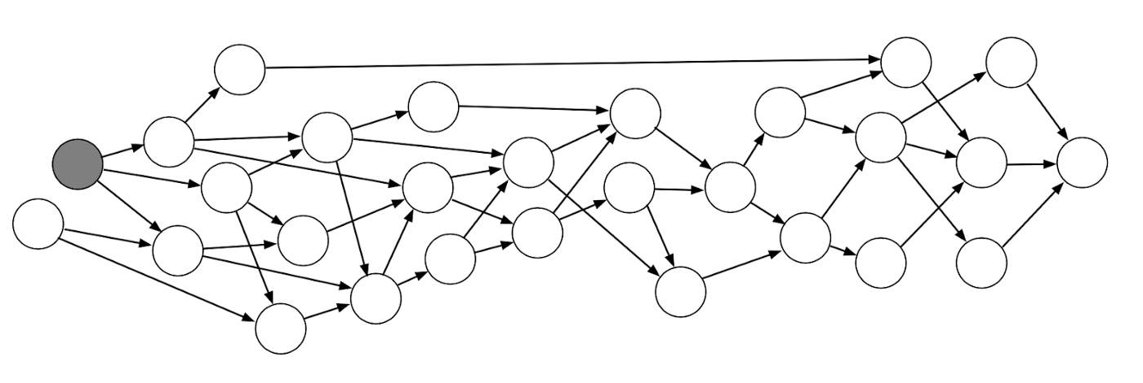

Slide 10
Graph Terminology
Unlabeled vs. Labeled Graphs
In a labeled graph, vertices and/or edges have data (labels) associated with them other than their unique identifier
Vertex-labeled graphs: graphs with labeled vertices
Edge-labeled graphs: graphs with labeled edges
A completely unlabeled graph is not useful.
Normally at least the vertices are labeled.
loves
Jane
John
Likes
Ann
Unlabeled Graph
Labeled Graph

Slide 11
Graph Terminology
Parallel Edges and Loops
Multigraph: Allowing multiple edges between the same pair of vertices
Pseudograph: An edge that starts and ends with the same vertex.
Simple Graph
Multigraph
Pseudograph

Slide 12
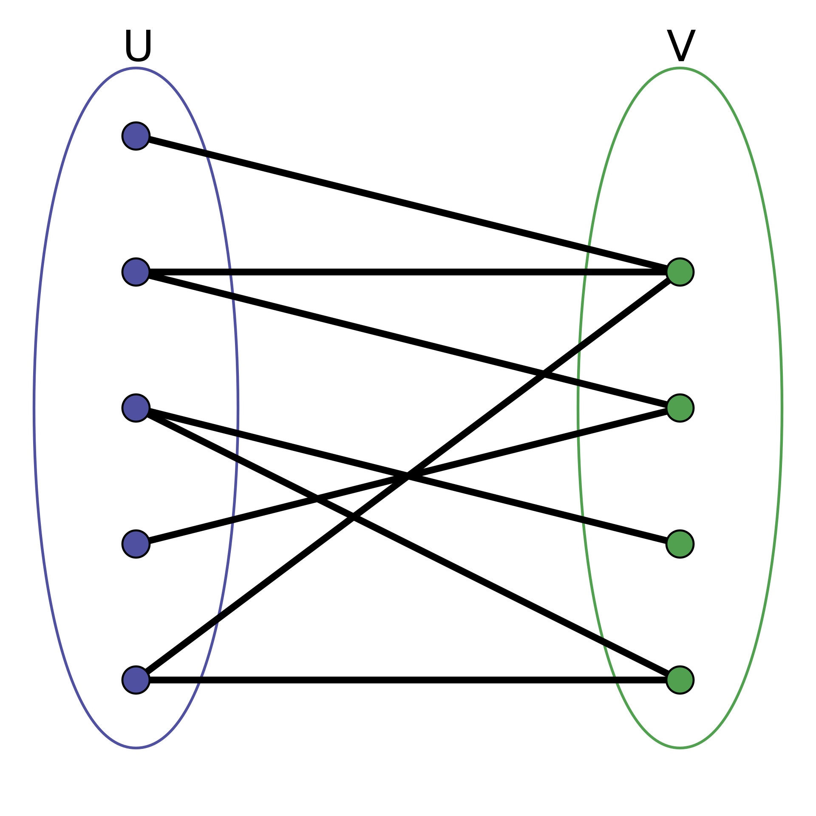
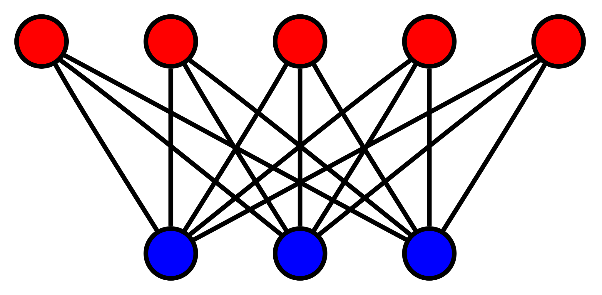
Graph Terminology
Bipartite Graph
A bipartite graph (or bigraph) is a graph whose vertices can be divided into two disjoint and independent sets U and V such that every edge connects a vertex in U to one V.
Vertex sets U and V are usually called the parts of the graph.
A bipartite graph is a graph that does not contain any odd-length cycles.
Source: https://en.wikipedia.org/wiki/Bipartite_graph

Slide 13
Graph Query Language
SPARQL
A SQL-like language promoted by W3C for querying Resource Description Framework (RDF) graphs
Cypher
A query language used in Neo4j, an open source database
Tinkerpop Gremlin
An attempt to create a standard interface to graph databases and processing systems.
GraphX + GraphFrame
Refer to https://en.wikipedia.org/wiki/GQL_(Graph_Query_Language)

Slide 14
Other Graph Processing Tools
JanusGraph (Distributed, open source, graph database)
Neo4j (open source, graph database)
ArangoDB (Distributed, open source, multi-model database)
Dgraph (Distributed, open source, graph database)
OrientDB (Distributed, open source, multi-model database)
TigerGraph (Proprietary graph database)
NetworkX (Python package for complex network analytics)
Azure CosmosDB (Cloud-native, multi-model database)
AWS Neptune (Cloud-native, graph database)

Slide 15
Why Graph Processing on Spark?
Relational databases are often not suited for graph analytics.
SQL is not built to present graph notions such as following a trail of connections.
Traditional methods of data processing fail to scale as the size of the data to be analyzed increase.
Graph processing systems (including Apache Spark GraphFrames) provide the means to create graph structures from raw data sources.
GraphX (RDD) and GraphFrames (DataFrame) are graph processing layers on top of Spark that bring the power of distributed and scalable Big Data processing to graphs.

Slide 16
Where is Graph used?
Fraud Detection & Analysis
Network and Database Infrastructure Monitoring for IT Operations
Recommended Engine & Product Recommendation Systems
Master Data Management
Identity and Access Management
Knowledge Graphs
Google Maps
Refer to https://neo4j.com/use-cases/

Slide 17
Where is Graph used?
Motif finding
Determining importance of papers in bibliographic networks (which papers are most referenced)
Ranking web pages (Google’s PageRank algorithm)
Other important things such as Six Degrees of Kevin Bacon (Social Media and Social Network Graphs)
Refer to https://neo4j.com/use-cases/

Slide 18
Spark Graph Analytics

Slide 19
Spark Graph Analytics
GraphX (kind of like spark.mllib)
RDD-based library
Provides low-level interface
Powerful, but not easy to use or optimize
GraphFrames (kind of like spark.ml)
Extends GraphX to provide a DataFrame API and support for Spark’s different language bindings so that users of Python can take advantage of the scalability of the tool.
Available as an external package.
Improved user experience with small penalty in performance due to some overhead .

Slide 20
Building a Graph
Users can create GraphFrames from vertex and edge DataFrames.
Define vertices and edges using DataFrames with special named columns.
Both DataFrames can have arbitrary other columns which can represent vertex and edge attributes.
A GraphFrame can also be constructed from a single DataFrame containing edge information.
The vertices will be inferred from the sources and destinations of the edges.

Slide 21
Building a Graph
Vertex DataFrame
Should contain a special column named “id” which specifies unique IDs for each vertex in the graph.
Edge DataFrame
Should contain two special columns:
“src” (source vertex ID of edge)
“dst” (destination vertex ID of edge)

Slide 22
Building a Graph
# Vertex DataFrame
v = sqlContext.createDataFrame([
("a", "Alice", 34),
("b", "Bob", 36),
("c", "Charlie", 30),
("d", "David", 29),
("e", "Esther", 32),
("f", "Fanny", 36),
("g", "Gabby", 60)
], ["id", "name", "age"])
# Edge DataFrame
e = sqlContext.createDataFrame([
("a", "b", "friend"),
("b", "c", "follow"),
("c", "b", "follow"),
("f", "c", "follow"),
("e", "f", "follow"),
("e", "d", "friend"),
("d", "a", "friend"),
("a", "e", "friend")
], ["src", "dst", "relationship"])
# Create a GraphFrame
g = GraphFrame(v, e)

Slide 23
Building a Graph
Define vertices and edges using DataFrames with special named columns.
To define a graph, use the naming conventions for columns presented in the GraphFrames library.
In the vertices table, define the identifier as id
In the edges tables, label each edge’s source vertex ID as src and destination ID as dst (for directed graph)
stationVertices = bikeStations.withColumnRenamed(”name”,”id”).distinct()
tripEdges = tripData \
.withColumnRenamed(“Start Station”, “src”)\
.withColumnRenamed(“End Station”, “dst”)
from graphFrames import GraphFrame
stationGraph = GraphFrame(stationVertices, tripEdges)
stationGraph.cache()

Slide 24
Querying the Graph
GraphFrames provide simple access to both vertices and edges as DataFrames.
Filter by any valid DataFrame expression
From pyspark.sql.functions import desc stationGraph.edges.groupBy(“src”, “dst”). \
count().orderBy(desc(“count”)).show(10)
stationGraph.edges
.where(“src=‘Townsend at 7th’ OR dst = ‘Townsend at 7th’”)
.groupBy(“src”, “dst”).count()
.orderBy(desc(“count”))
.show(10)

Slide 25
Subgraphs
Subgraphs are smaller graphs within the larger one
townAnd7thEdges = stationGraph.edges \
.where(“src = ‘Townsend at 7th’ OR dst = ’Townsend at 7th’”)
subgraph = GraphFrame(stationGraph.vertices, townAnd7thEdges)

Slide 26
Motif Finding
Motifs are a way of expressing structural patterns in a graph.
When a motif is specified, patterns are queried instead of actual data.
In GraphFrames, a query is specified in a domain-specific language similar to Neo4J’s Cypher language.
Allows specifying of combinations of vertices and edges and assign them names.
Specify that a given vertex connects to another vertex b through an edge ab: (a)-[ab]->(b)
The names inside parentheses or brackets do not signify values but instead what the columns for matching vertices and edges should be named in the resulting DataFrame.
The names can be omitted if the resulting values don’t need to be queried. (e.g. (a)-[]->())

Slide 27
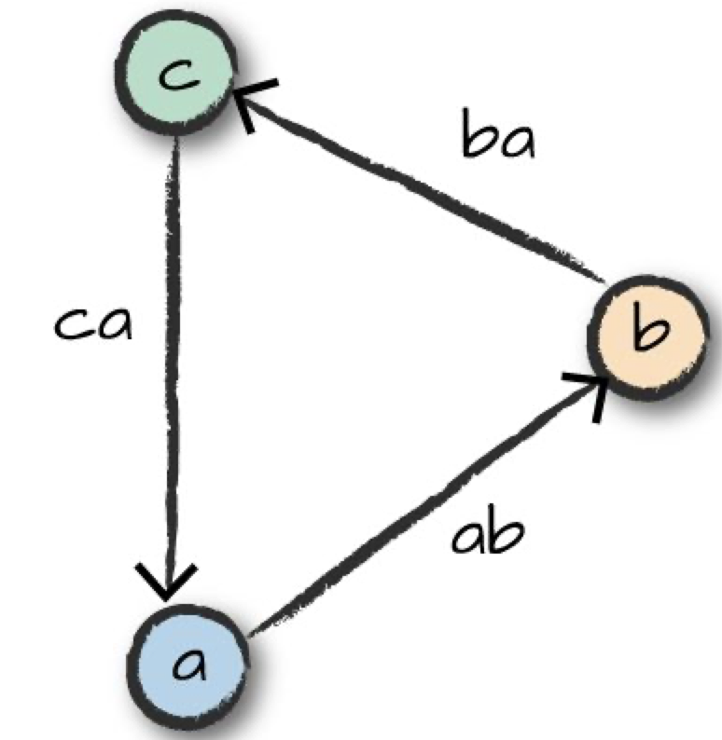
Motif Finding
Find all the rides that form a ”triangle” pattern between three stations.
motifs = stationGraph.find(“(a)-[ab]->(b);(b)-[bc]->(c);(c)-[ca]->(a)”)
(a) signifies the starting station
[ab] represents an edge from (a) to the next station (b)
This is repeated for stations (b) to (c), and then from (c) to (a)
The resulting DataFrame from the query contains nested fields for vertices a, b, and c, as well as respective edges.
The resulting query can be queried just like any other DataFrames.

Slide 28
Graph Algorithms
A graph is a logical representation of data
Graph theory provides numerous algorithms for analyzing graph data.
GraphFrames provides a number of algorithms out of the box.
http://graphframes.github.io/graphframes/docs/_site/user-guide.html#graph-algorithms

Slide 29
Types of Graph Algorithms
Pathfinding
Finding shortest path from vertex A to vertex B.
e.g. Google Map.
Centrality
Understanding which nodes are important within the network.
e.g. Who is the central figure in the class? Who is most popular important person? Web search ranking.
Community Detection
Used to find communities (sub-structures/graphs) and quantify the quality of groupings.
Reference: Graph Algorithms - Practical Examples in Apache Spark & Neo4j, O’reilly 2019

Slide 30
Graph Algorithms - PageRank
Created by Larry Page (cofounder of Google) as a research project for how to rank web pages.
A way to measure the “authority” or centrality of vertices in a graph
It measures the transitive (directional) influence of nodes.
PageRank considers the influence of a node’s neighbors, and their neighbors.
It is not based on the number of vertices that have edges pointing to the vertex in question, but on the PageRanks of those vertices.
Measures the number and quality of incoming relationships to a vertex to determine an estimation of how important the vertex is.

Slide 31
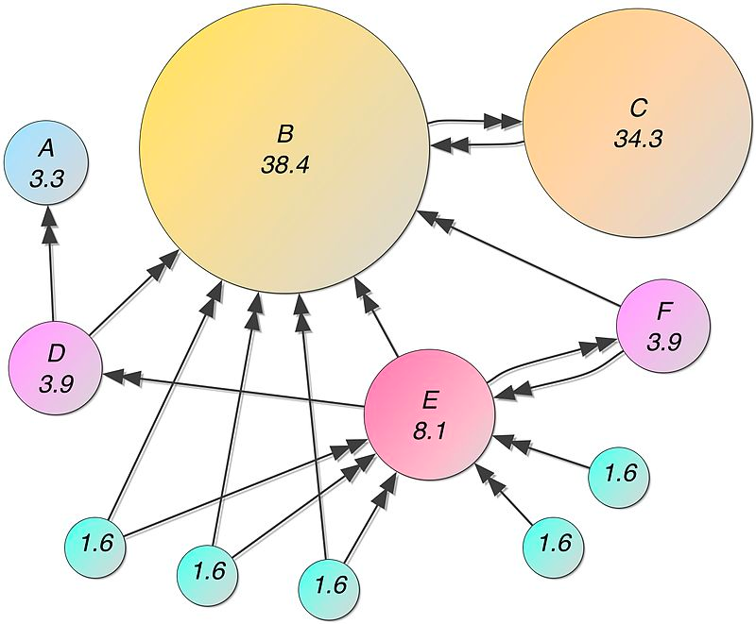
Graph Algorithms - PageRank
https://en.wikipedia.org/wiki/PageRank

Slide 32
Graph Algorithms - PageRank
The results of the algorithm are stored as one or more columns in the GraphFrame’s vertices and/or edges or the DataFrame
For PageRank, the algorithm returns a GraphFrame. Estimated PageRank values for each vertex can be extracted from the new pagerank column.
from pyspark.sql.functions import desc
ranks = stationGraph.pageRank(resetProbability=0.15, maxIter=10)
ranks.vertices.orderBy(desc(“pagerank”)).select(“id”,”pagerank”).show(10)

Slide 33
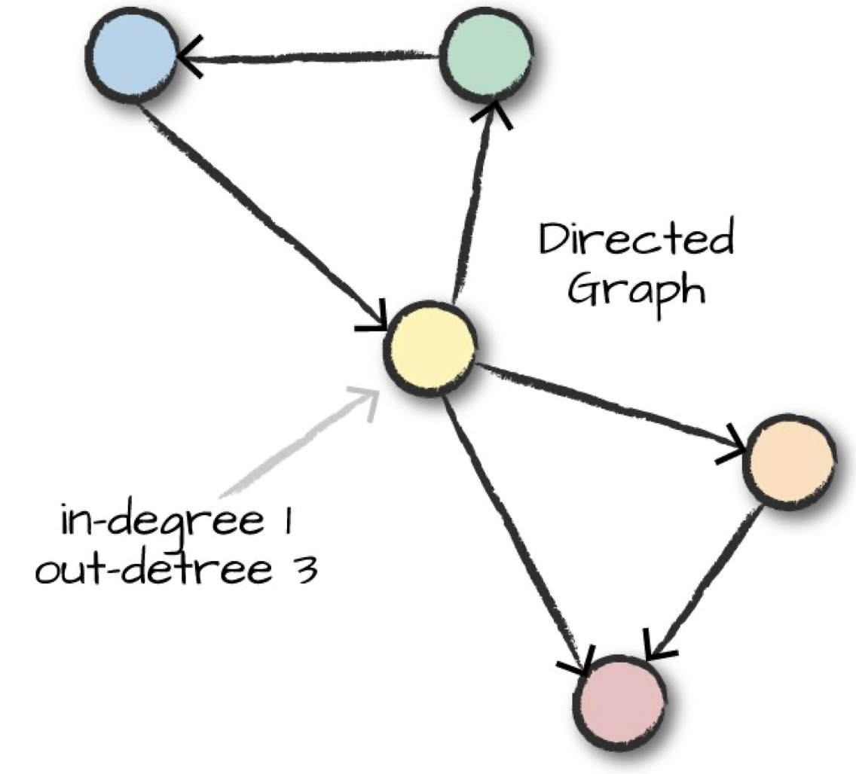
In-Degree and Out-Degree Metrics
One of the common task is to count the number of edges that are inbound and outbound in relation to a vertex.
Applicable in the context of social networking.

Slide 34
In-Degree and Out-Degree Metrics
The results of the algorithm are stored as one or more columns in the GraphFrame’s vertices and/or edges or the DataFrame
High ratio: where large number of trips end. Lower ratio: where the trips start
outDeg = stationGraph.outDegrees
outDeg.orderBy(desc(“outdegree”)).show(5, False)
degreeRatio = inDeg.join(outDeg, “id”)\
.selectExpr(“id”, “double(indegree)/double(outDegree) as degreeRatio”)
degreeRatio.orderBy(desc(“degreeRatio”)).show(10, False)
degreeRatio.orderBy(“degreeRatio”).show(10, False)

Slide 35
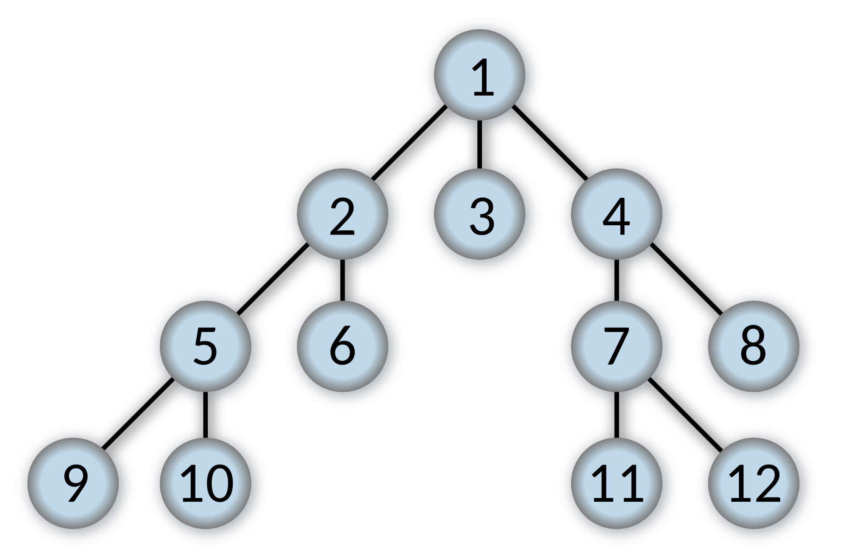
Breadth-First Search
Breadth-first search searches a graph for how to connect two sets of nodes based on the edges in the graph. E.g. Find shortest paths to different bike stations.
Explores the vertices of a graph in layers in order of increasing distance from the starting vertex.

Slide 36
Breadth-First Search
maxLengthPath: maximum edges to follow
Possible to specify an edgeFilter to filter out edges that do not meet a requirement
stationGraph.bfs(fromExpr=“id=‘Townsend at 7th’”,
toExpr = “id=’Spear at Folsom’”), maxPathLength = 2). show(10)

Slide 37
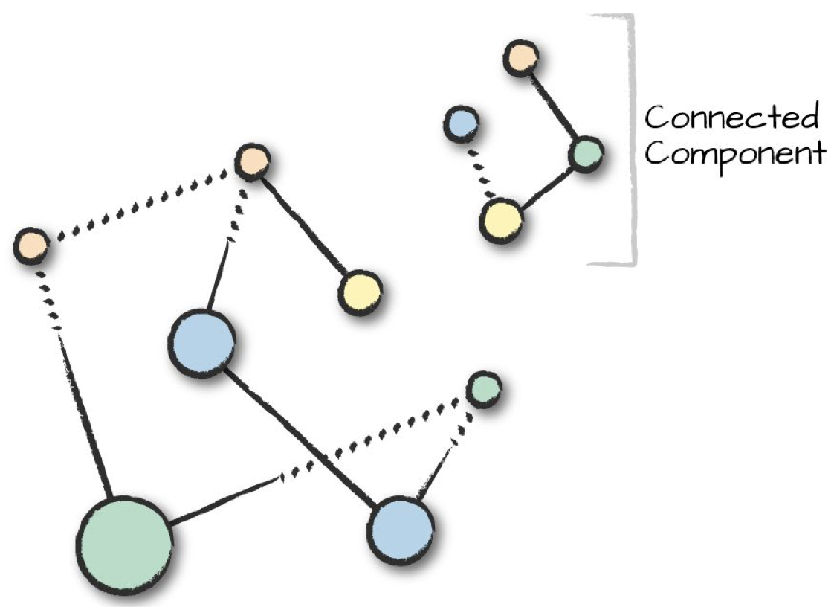
Connected Components
A connected component defines an (undirected) subgraph that has connections to itself but does not connect to the greater graph.
Connected component assumes an undirected graph.
One of the most expensive algorithms in GraphFrames.

Slide 38
Connected Components
spark.sparkContext.setCheckpointDir(“/tmp/checkpoints”)
minGraph = GraphFrame(stationVertices,
tripEdges.sample(False, 0.1))
Cc = minGraph.connectedComponents()
cc.where(“components != 0”).show()

Slide 39
Strongly Connected Components
Strongly connected components takes directionality into account.
Strongly connected component is a subgraph that has paths between all pairs of vertices inside it.
scc = minGraph.stronglyConnectedComponents(maxIter = 3)
scc.groupBy(“component”).count().show()

Slide 40
Saving and Loading

Slide 41
Saving and Loading
Since GraphFrames are built around DataFrames, they automatically support saving and loading to and from the same set of datasources.
from graphframes.examples import Graphs
g = Graphs(sqlContext).friends() # Get example graph
# Save vertices and edges as Parquet to some location.
g.vertices.write.parquet("hdfs://myLocation/vertices")
g.edges.write.parquet("hdfs://myLocation/edges")
# Load the vertices and edges back.
sameV = sqlContext.read.parquet("hdfs://myLocation/vertices")
sameE = sqlContext.read.parquet("hdfs://myLocation/edges")
# Create an identical GraphFrame.
sameG = GraphFrame(sameV, sameE)

Slide 42
Useful Links
GraphFrames user guide:
https://graphframes.github.io/graphframes/docs/_site/user-guide.html
https://docs.databricks.com/spark/latest/graph-analysis/graphframes/user-guide-python.html
Graph Algorithm e-Book (free):
https://neo4j.com/lp/book-graph-algorithms/
https://resources.oreilly.com/examples/0636920233145
https://github.com/neo4j-graph-analytics/book/blob/master/data/188591317_T_ONTIME.csv.gz
PageRank
PageRank Beyond the Web: https://arxiv.org/abs/1407.5107
https://graphframes.github.io/graphframes/docs/_site/user-guide.html#pagerank
PageRank Convergence: https://stackoverflow.com/a/29321153

Slide 43
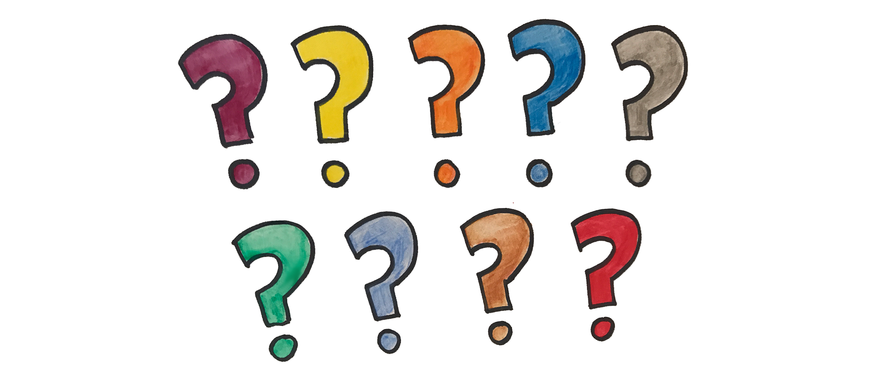
Questions

